Slide 1

BUSINESS ANALYTICS CLUB
Workshop Series 10.3
Programming Basics
In Scratch
Samantha Rettie

Slide 2
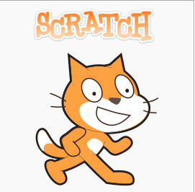
Scratch
Officially started in 2005
Scratch is a visual programming language
Great transition into advanced languages
Scratch is an event driven language using Sprites

Slide 3
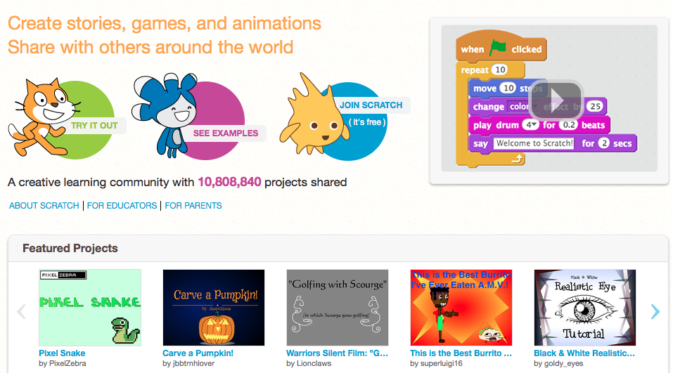
Exploring Scratch

Slide 4
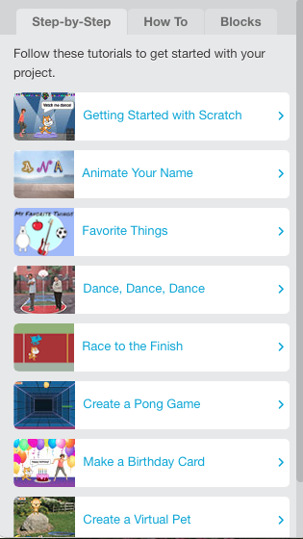
Your Helper
One section of the Helper provides you with step-by-step tutorials of how to code within your project

Slide 5
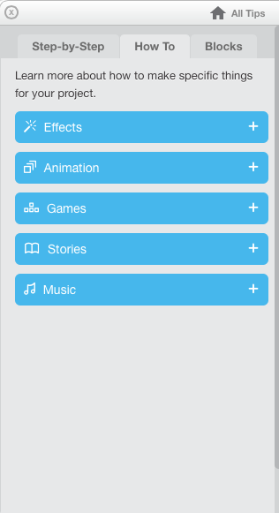
Your Helper
Another section teaches you how to make specific projects including: special effects, animations, games, and etc

Slide 6
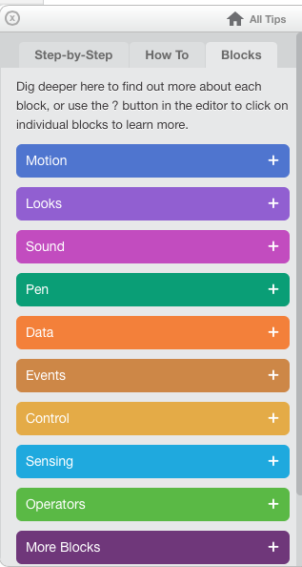
Your Helper
Your Helper can also give you in depth descriptions on how to use each of the script blocks to perfect your project!

Slide 7
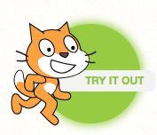

Slide 8
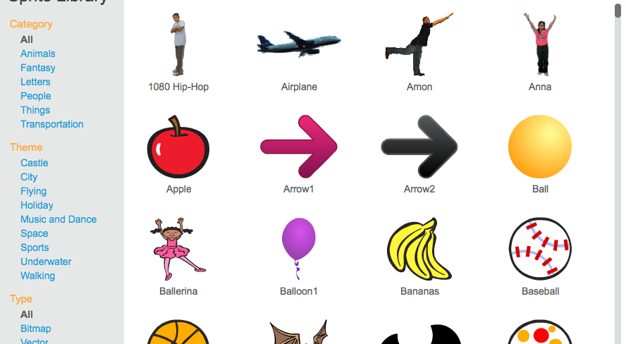
Sprites
Sprites are your characters. These are objects (X’s) that you will control within your project.

Slide 9
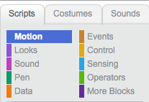
Controls
These are your controls. They will be used throughout your project

Slide 10
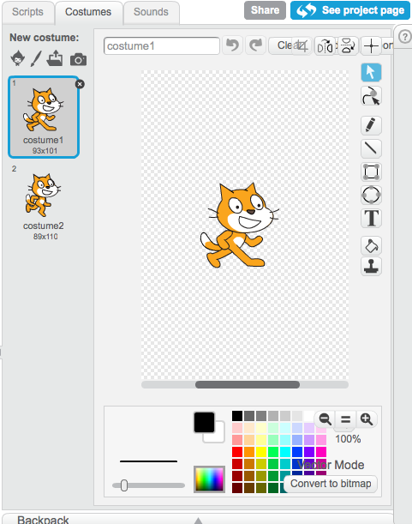
Controls: Costumes
This is where you can change the look of your sprite. You can pick from pre-set sprites and adjust them or even make your own!

Slide 11
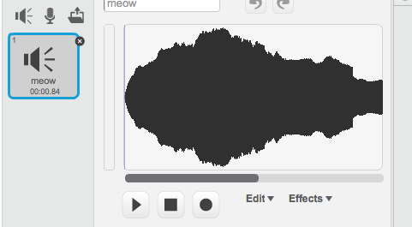
Controls: Sound
Sound allows you to upload or create sounds to add to your project

Slide 12
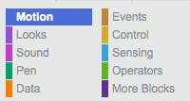
Control: Scripts
Lastly, there are Scripts. These scripts are where you choose the blocks in order to create your project. Each block allows you to perform a specific action to animate your sprites and sounds!

Slide 13
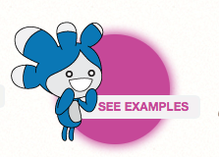
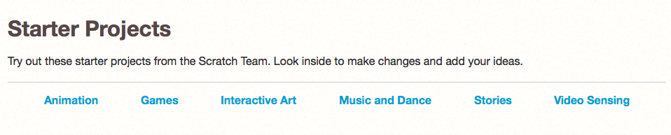
10+ Million Projects Shared

Slide 14
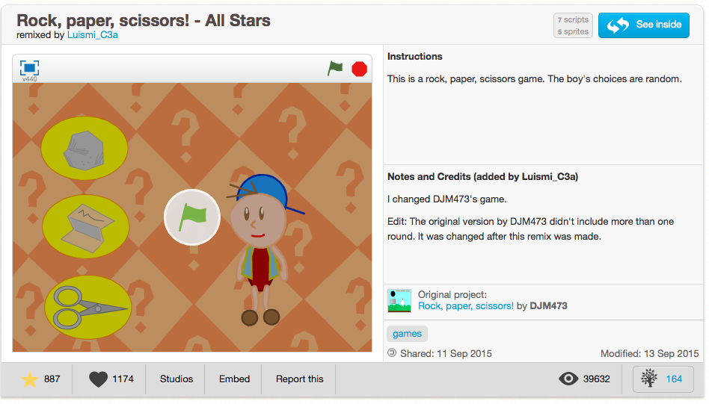

Example Project
scratch.mit.edu/projects/76185486
A great example of randomization!
$$x$$

Slide 15
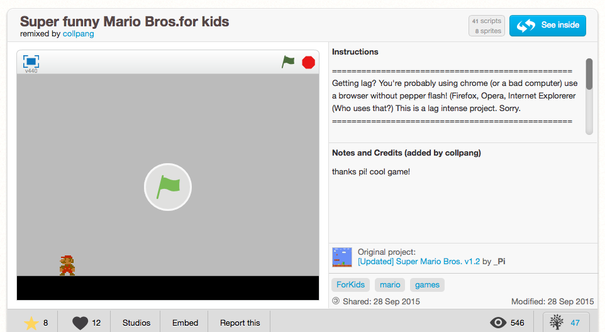
Example Project
scratch.mit.edu/projects/76185486
Here we can see an example of side scrollers and an entire world that was imported by the project owner!
$$x$$

Slide 16
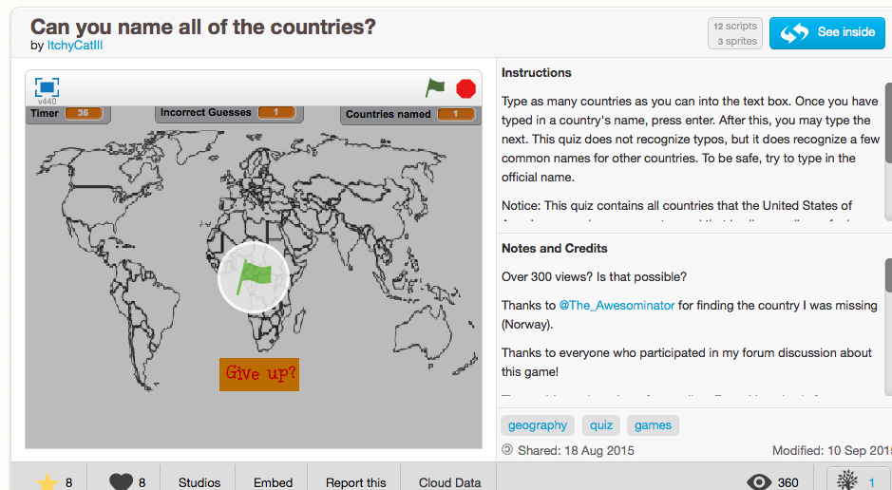
Example Project
scratch.mit.edu/projects/73416386/#player
Ever play Sporcle? You can do that here! This example is a time based project where you must type in your guess!
$$x$$

Slide 17
Let’s try it ourselves!

